Slide 1
Template and Namespace
Nilanjana G. Basu, HIT, Kolkata

Slide 2
function template
#include<iostream>
using namespace std;
template <class T>
T min(T & x,T & y){return (x<=y?x:y);}
int main(){int a,b;
cout<<"Enter two integers"<<endl;
cin>>a>>b;
cout<<"Min:"<<min(a,b)<<endl;
float c,d;
cout<<"Enter two floats"<<endl;
cin>>c>>d;
cout<<"Min:"<<min(c,d)<<endl;
char e,f;
cout<<"Enter two char"<<endl;
cin>>e>>f;
cout<<"Min:"<<min(e,f)<<endl;
return 0;
}

Slide 3
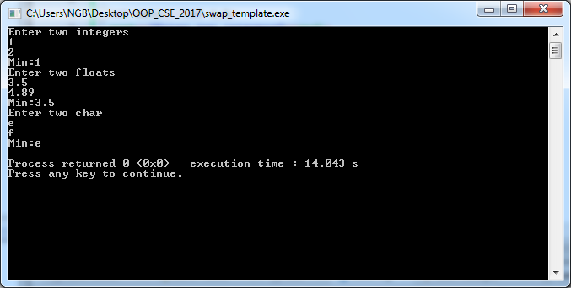
Output

Slide 4
class template
#include<iostream>
using namespace std;
#define maxsize 5
template <class T>
class Stack{T var[maxsize]; int top;
public:
Stack(){top=-1;}
void push(T x){if(top==maxsize-1) cout<< "Overflow"<<endl;
else
{var[++top]=x;cout<<"element pushed"<<var[top]<<endl;}
}
T pop();
};
template <class T>
T Stack<T>::pop(){ if (top==-1) {cout<<"underflow"<<endl; return -1;}
else return var[top--];}

Slide 5
Contd..
int main(){
Stack<int> obj;
obj.pop();
for(int i=0;i<=maxsize;i++)
obj.push(i);
cout<<"element popped"<<obj.pop()<<endl;
cout<<"element popped"<<obj.pop()<<endl;
Stack<float> obj2;
obj2.pop();
for(int i=0;i<=maxsize;i++)
obj2.push(i+1.5);
cout<<"elemenet popped"<<obj2.pop()<<endl;
cout<<"element popped"<<obj2.pop()<<endl;
return 0;
}

Slide 6
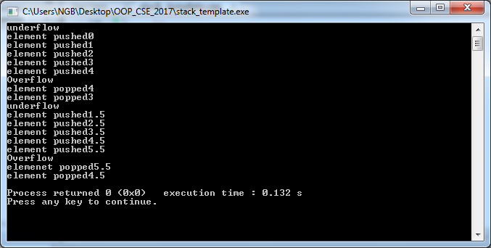
output

Slide 7
class matrix with *operator overloading
#include<iostream>
using namespace std;
class matrix{
int **m; int row,col;
public:
matrix(int r, int c):row(r),col(c){
m=new int*[row];
for(int i=0;i<row;i++)
m[i]=new int[col];
cout<<"Enter values"<<endl;
for(int i=0;i<row;i++)
for(int j=0;j<col;j++)
cin>>m[i][j];
}
matrix(){}

Slide 8
Contd..
matrix operator *(matrix obj){matrix result;
result.row=row; result.col=obj.col;
result.m=new int*[result.row];
for(int i=0;i<result.row;i++)
result.m[i]=new int[result.col];
for(int i=0;i<result.row;i++)
for(int j=0;j<result.col;j++)
result.m[i][j]=0;
for(int i=0;i<row;i++)
{for(int j=0;j<obj.col;j++)
{for(int k=0;k<col;k++)
result.m[i][j]+=m[i][k]*obj.m[k][j]; }}
return result;}

Slide 9
Contd..
void display(){
for(int i=0;i<row;i++)
{for(int j=0;j<col;j++)
{cout<<m[i][j]<<" ";}
cout<<endl;
}
}
~matrix(){
for (int i=0;i<row;i++)
delete m[i];
delete m;
}
};
int main(){
matrix m1(2,3);
matrix m2(3,2);
m1.display();
m2.display();
matrix m3=m1*m2;
m3.display();
}

Slide 10
template class matrix with*operator overloading
template<class T>
class matrix{
T **m; int row,col;
public:
matrix(int r, int c):row(r),col(c){
m=new T*[row];
for(int i=0;i<row;i++)
m[i]=new T[col];
cout<<"Enter values"<<endl;
for(int i=0;i<row;i++)
for(int j=0;j<col;j++)
cin>>m[i][j];
}
matrix(){}

Slide 11
Contd..
matrix operator *(matrix obj){matrix result;
result.row=row; result.col=obj.col;
result.m=new T*[result.row];
for(int i=0;i<result.row;i++)
result.m[i]=new T[result.col];
for(int i=0;i<result.row;i++)
for(int j=0;j<result.col;j++)
result.m[i][j]=0;
for(int i=0;i<row;i++)
{for(int j=0;j<obj.col;j++)
{for(int k=0;k<col;k++)
result.m[i][j]+=m[i][k]*obj.m[k][j];} }
return result;}

Slide 12
Contd..
void display(){
for(int i=0;i<row;i++)
{for(int j=0;j<col;j++)
{cout<<m[i][j]<<" ";}
cout<<endl;
}
}
~matrix(){
for (int i=0;i<row;i++)
delete m[i];
delete m;
}
};
int main(){
matrix <int> m1(2,3);
matrix <int> m2(3,2);
cout<<"1st matrix"<<endl;
m1.display();
cout<<"2nd matrix"<<endl;
m2.display();
matrix<int> m3=m1*m2;
cout<<"Result matrix"<<endl;
m3.display();
}

Slide 13
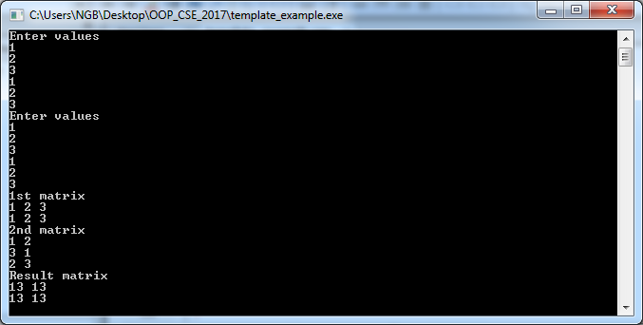
Output

Slide 14
friend function to two non-template classes
#include<iostream>
using namespace std;
class B;
class A{
int x;
public:
A(int m):x(m){}
friend void swap(A&, B&);
void show(){cout<<x<<endl;}
};
class B{
int x;
public:
B(int m):x(m){}
friend void swap(A&, B &);
void show(){cout<<x<<endl;}
};

Slide 15
Contd..
void swap(A & obj1,B & obj2){int temp;
temp=obj1.x;
obj1.x=obj2.x;
obj2.x=temp;
}
int main(){
A a(10);
B b(20);
swap(a,b);
a.show();b.show();}

Slide 16
template function is a friend of two template classes
template<class T>
class B; //forward declaration
template<class T>
class A{
T x;
public:
A(T m):x(m){}
template<class U>
friend void swap(A<U>&, B<U> &);
void show(){cout<<x<<endl;}
};

Slide 17
Contd..
template<class T>
class B{
T x;
public:
B(T m):x(m){}
template<class U>
friend void swap(A<U>&, B<U> &);
void show(){cout<<x<<endl;}
};

Slide 18
Contd..
template<class T>
void swap(A <T> & obj1,B <T> & obj2){T temp;
temp=obj1.x;
obj1.x=obj2.x;
obj2.x=temp;
}
int main(){
A<int> a(10);
B<int> b(20);
swap(a,b);
a.show();b.show();
}

Slide 19
Another way
#include<iostream>
using namespace std;
template<class T>
class B;
template<class T>
class A;
template<class T>
void swap(A<T>&, B<T>&);
template<class T>
class A{
T x;
public:
A(T m):x(m){}
friend void swap<T>(A<T>&, B<T> &);
void show(){cout<<x<<endl;}
};

Slide 20
Contd..
template<class T>
class B{
T x;
public:
B(T m):x(m){}
friend void swap<T>(A<T>&, B<T> &);
void show(){cout<<x<<endl;}
};

Slide 21
Contd..
template<class T>
void swap(A <T> & obj1,B <T> & obj2){
T temp;
temp=obj1.x;
obj1.x=obj2.x;
obj2.x=temp;
}
int main(){
A<int> a(10);
B<int> b(20);
swap(a,b);
a.show();b.show();
}

Slide 22
Template Specialization
#include<iostream>
using namespace std;
template <class T>
class Spcl_temp
{
T var;
public:
Spcl_temp(T x):var(x){cout<<var<<endl;}
T Double(){return 2*var;}
};
template <>
class Spcl_temp <string>
{
string var;
public:
Spcl_temp(string x):var(x){cout<<"R"<<var<<endl;}
string Double(){return var.append(var);}
};
int main(){
Spcl_temp <int> obj1(1);
Spcl_temp <float> obj2(1.5);
Spcl_temp<string> obj3("am");
cout<<obj1.Double()<<" " <<obj2.Double()<<" "<<obj3.Double()<<endl;
}

Slide 23
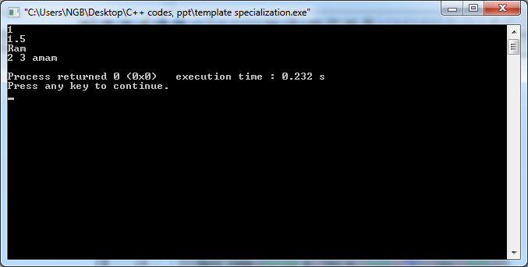
output

Slide 24
Namespace
A namespace is a declarative region that provides a scope to the identifiers (the names of types, functions, variables, etc) inside it.
Namespaces are used to organize code into logical groups and to prevent name collisions that can occur especially when your code base includes multiple libraries.
All identifiers at namespace scope are visible to one another without qualification.
Identifiers outside the namespace can access the members by using the fully qualified name for each identifier, for example std::cout;, or else by a using Declaration for a single identifier (using std::cout), or a using Directive for all the identifiers in the namespace (using namespace std;).
Code in header files should always use the fully qualified namespace name.

Slide 25
Examples
#include<iostream>
using namespace std;
int main(){cout<<"HI";}
---------------------------------------
#include<iostream>
using std::cout;
int main(){cout<<"HI";}
----------------------------------------
#include<iostream>
int main(){std::cout<<"HI";}

Slide 26
Examples
#include<iostream>
using namespace std;
namespace n1{
void meth1(){cout<<"Inside n1"<<endl;}
}
namespace n2{
void meth1(); //defining outside
}
void n2::meth1(){cout<<"Inside n2"<<endl;}
int main(){n1::meth1();n2::meth1();}

Slide 27
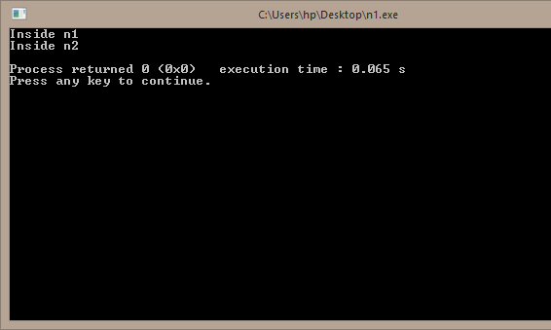
output

Slide 28
Nested namespace
#include<iostream>
using namespace std;
namespace n1{
void meth(){cout<<"Inside n1"<<endl;}
namespace n2{
void meth(){cout<<"Inside n2"<<endl;}
}
}
int main(){n1::meth();n1::n2::meth();}

Slide 29
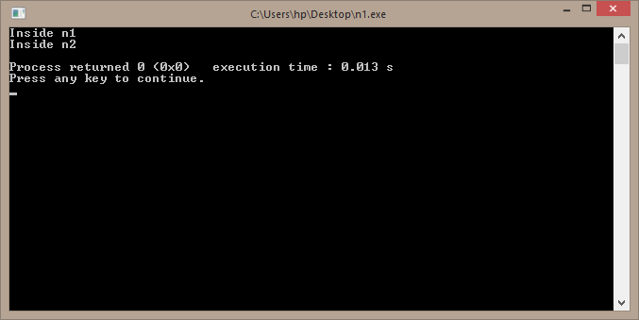
output

Slide 30
Inline namespace
#include<iostream>
using namespace std;
namespace n1{
void meth1(){cout<<"Inside n1"<<endl;}
inline namespace n2{
void meth2(){cout<<"Inside n2"<<endl;}
}
}
int main(){n1::meth1();n1::meth2();}

Slide 31
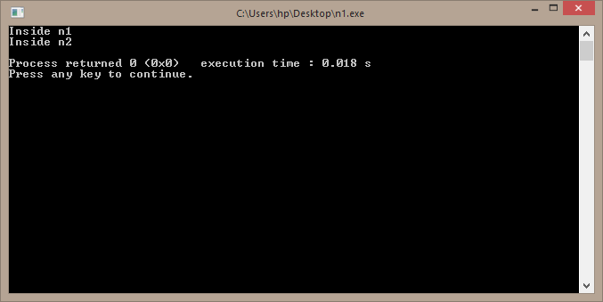
Output

Slide 32
another example
#include<iostream>
using namespace std;
namespace n1{
float PI=3.14;
float avg(int arr[],int length){
float total=0;
for(int i=0;i<length;i++)
total+=arr[i];
return (float)total/length;
}
}
float area(int r){return n1::PI*r*r; }
int main(){
int a[]={1,2,3,4,6};
cout<<n1::avg(a,5)<<endl;
cout<<area(1);
}

Slide 33
Using namespace
//namespace_example.h
#include<iostream>
using namespace std;
namespace n1{
float PI=3.14;
float avg(int arr[],int length){
float total=0;
for(int i=0;i<length;i++)
total+=arr[i];
return (float)total/length;
}
}//end of namespace
float area(int r){return n1::PI*r*r; }
#include<iostream>
#include"namespace_example.h"
using namespace std;
using namespace n1;
int main(){
int a[]={1,2,3,4,6};
cout<<avg(a,5)<<endl;
cout<<area(1);
}

Slide 34
Global Namespace
If an identifier is not declared in an explicit namespace, it is part of the implicit global namespace.
In general, try to avoid making declarations at global scope when possible, except for the entry point main Function, which is required to be in the global namespace.
To explicitly qualify a global identifier, use the scope resolution operator with no name, as in ::SomeFunction(x);
This will differentiate the identifier from anything with the same name in any other namespace, and it will also help to make your code easier for others to understand.

Slide 35
Example
namespace n2{
void meth2();
}
void meth2(){cout<<"Inside meth2"<<endl;}
int main(){n2::meth2(); ::meth2();}

Slide 36
Namespace alias
namespace a_very_long_namespace_name { class Foo {}; }
namespace AVLNN = a_very_long_namespace_name;
void Bar(AVLNN::Foo foo){ }

Slide 37
Anonymous Namespace
namespace
{
int MyFunc(){cout<<"Inside Anonymous"<<endl;}
}
int main(){::MyFunc(); }

